Slide 1
QuaLex Manufacturing
Simple Solutions to Complex Problems

Slide 2
QuaLex…
QuaLex Manufacturing www.qualexmanufacturing.com
Georgetown Ky – 90,000 SQFT Sheet Metal MFG
Lexington KY – 30,000 SQFT Sheet Metal MFG
Chambersburg PA – 35,000 SQFT Sheet Metal MFG
QuaLex Machining www.qualexmachining.com
Richmond KY – 100,000 SQFT Machining, Heavy Fab MFG
Moore Communications www.moorecp.com
Georgetown Ky – 20,000 SQFT Enclosure MFG
Advantech Bakery Technology www.advantechbake.com
Richmond Ky – 25,000 SQFT Industrial Baking Design, Fab and Install
450+ Employees 4 locations

Slide 3
QuaLex 2015/2016/2017 Capital Investments
14 FT Brake Press for additional redundancy on capabilities
6000 WATT Fiber laser July of 2015
6000 WATT Fiber laser Dec of 2017
Paint and Sand Blast Booth for Richmond Location Nov 2015
Powder Paint Booth for Chambersburg PA Location Dec 2017
14 FT Trumpf Brake July 2017
6 FT Trumpf Brake July 2017
6 FT Trumpf Brake Jan 2018
$3.4 mil total capital investment 2015/2016/2017

Slide 4
Equipment Listing Sheet metal
Capabilities
Sheet Metal Capabilities
• Maximum sheet size 5’ x 12’ sheets up to 2” thick
• Maximum bend length 14’
• Capable of welding hot roll, cold roll, galvanized, stainless and aluminum
Major Equipment
(1) CNC EMK3610 Turret Punch Press / Amada
(5) CNC Vipros 367 Turret Punch Press / Amada
(3) CNC Vipros 357 Turret punch Press / Amada
(1) CNC Pega 244 Turret Punch Press / Amada
(3) CNC Fiber Laser / Bistronic and Trumpf
(6) CNC Laser / Bistronic
(2) 60 Ton Fully Automated Brake Press / Amada
(4) 80 Ton Fully Automated Brake Press / Amada
(4) 100 Ton Fully Automated Brake Press / Amada
(6) 184 Ton Fully Automated Brake Press / Amada
70+ MIG Welders
(4) Spot Welders
Hanging Spot Gun
Fabrication Capabilities
Using our diverse equipment and staff of 450+ skilled employees we are capable of a wide range of custom fabrications.
Finishing Capabilities
Powder coating through a strategic partnering venture.
Plating through a strategic partnering venture.
General Capabilities
Foaming technology – 2 stage foam used in place of insulation – currently used for HVAC industry.
Qualex is a proven supplier in a JIT environment.
QuaLex has a proven scheduling and office management system that insures on time delivery.
QuaLex has a Rapid Response Team in place to handle your rush production requirements.
Our CAD/CAM system for both the Machining and Sheet Metal areas is capable of handling a variety of drawing formats. We can accept e-mailed drawing files in most formats.

Slide 5
Equipment Listing Machining
Turning Equipment
(1) MAZAK QT 35 with 6.5 through hole – 24” Swing capable of turning shafts 11” dia. X 60” long and Conversational Controls.
(2) MAZAK QT 28S – 16” Swing capable of turning shafts 11” dia. X 40” long and Conversational Controls.
(2) MAZAK M/4 Turning Centers – 20” Swing capable of turning shafts 11” dia. X 60” long and Conversational Controls.
(2) MAZAK QT 20S - 20” Swing capable of turning shafts 11” dia. X 40” long and Conversational Controls.
Vertical Machining Centers
(3) MAZAK V-15N Vertical Machining Center – 40”x25”x20” Travels equipped with Ultimax Conversational CNC Controls
(1) HURCO BMC 4020 – 40”x20” Travels equipped with Ultimax SSM controls
(1) HAAS Vertical Mill
Horizontal Machining Centers
(1) CINCINNATI MILACRON 10-HC – Acramatic CNC controls with Indexable table
(2) MAZAK H-15 POWER CENTER – Indexable Pallets
(1) HAAS HORIZONTRAL MILL – Indexable Pallets
Horizontal Boring Mills: (Some of the largest boring mills in the area)
(1) CINCINNATI GILBERT CNC BORING MILL – 6’x8’ Travels with Indexable Table.
(1) OLYMPIA ENGINEERING HT100x60 – 100”X x 63”Y Travel with Indexable Table. 22,000# load capacity.
(1) GIDDINGS & LEWIS G60T – 96”X x 120”Y Travel with Indexable Table. 35,000# load capacity
Cutting Equipment
(1) 2017 Trumpf 6000 Watt Fiber Laser
(2) AMADA COMA TURRETS – 55 ton.
(2) SECTOR 260HD PLASMA CUTTERS – Max plate size 72” x 144”. Max thickness 1.5” (plasma cut) and 6” (Oxy-fuel cut).
Forming Equipment
(2) CINCINNATI BRAKE PRESS – 10ft bed length. 350 ton capacity
(2) AMADA RG100 – 10ft bed length. 100 ton capacity
(1) AMADA RG80 – 6ft bed length. 80 ton capacity
General Equipment
WARNER/SWASEY Turret Lathe
PEERLESS HB 10/12 Cut Off Saw
ACER 4VK Knee Mill
KALAMAZOO Cut Off Saw
(5) BRIDGEPORT Knee Mills
BOYAR/SHULTZ 6-12 Surface Grinder
BRIDGEPORT with EZ-TRACK Controls
COSEN Dual Column Production Saw

Slide 6
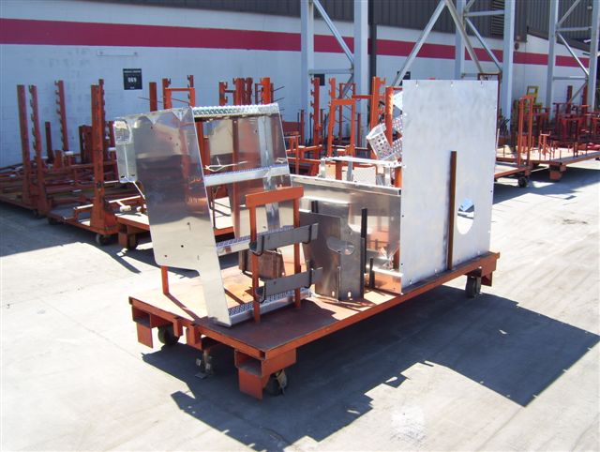
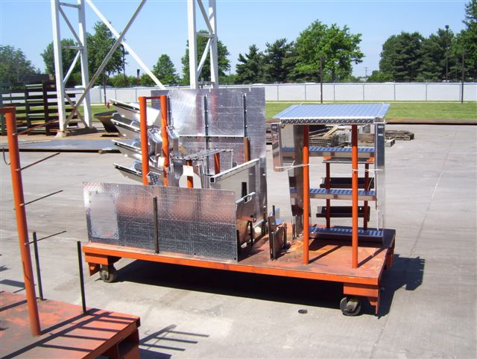
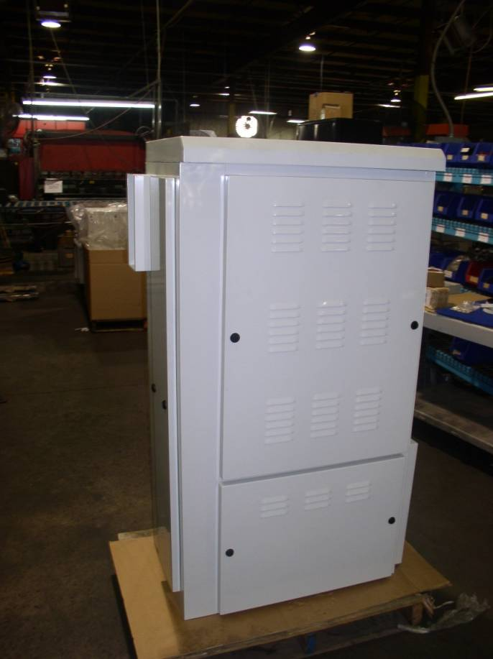
QuaLex Products
Kit complete parts for Cranes

Slide 7
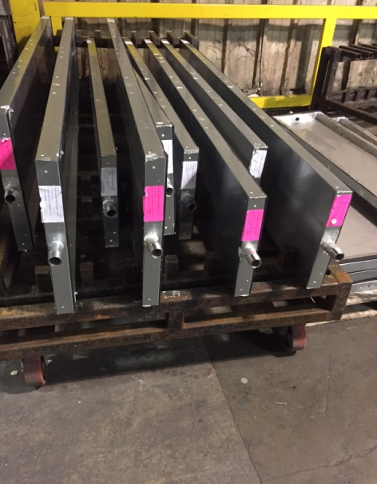
QuaLex Product Continued
Line Side Daily Deliveries

Slide 8
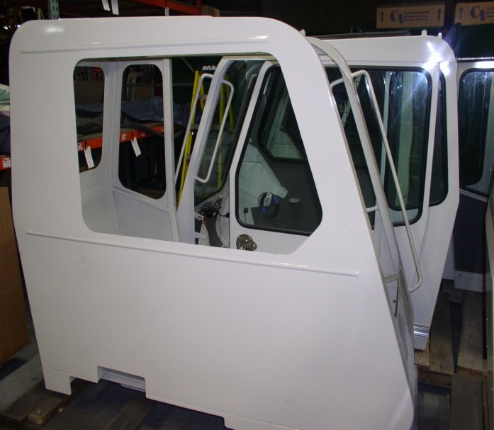
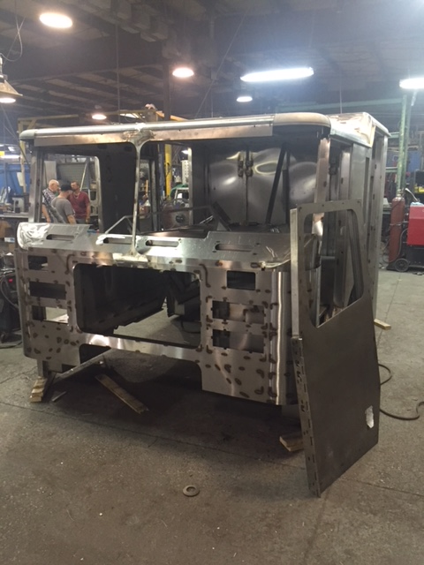
QuaLex Product Continued
Construction Cabs Fire Truck Cabs

Slide 9
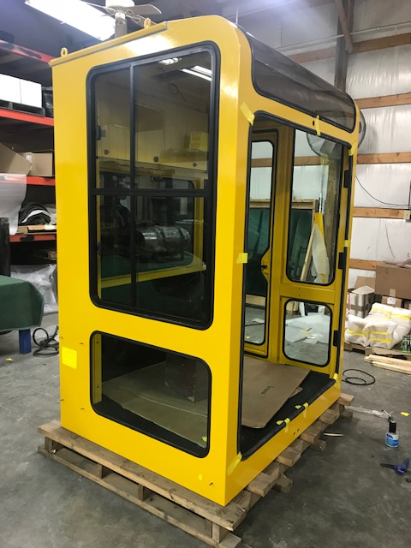
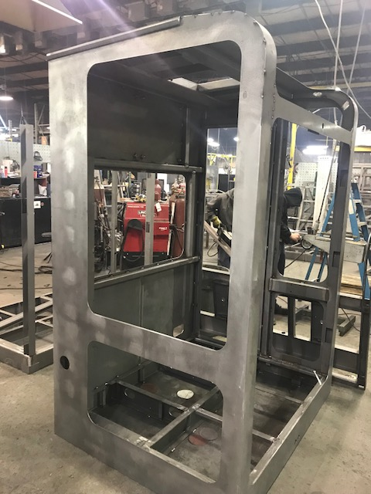
QuaLex Product Continued
Man Cab Fabrications and Assembly

Slide 10
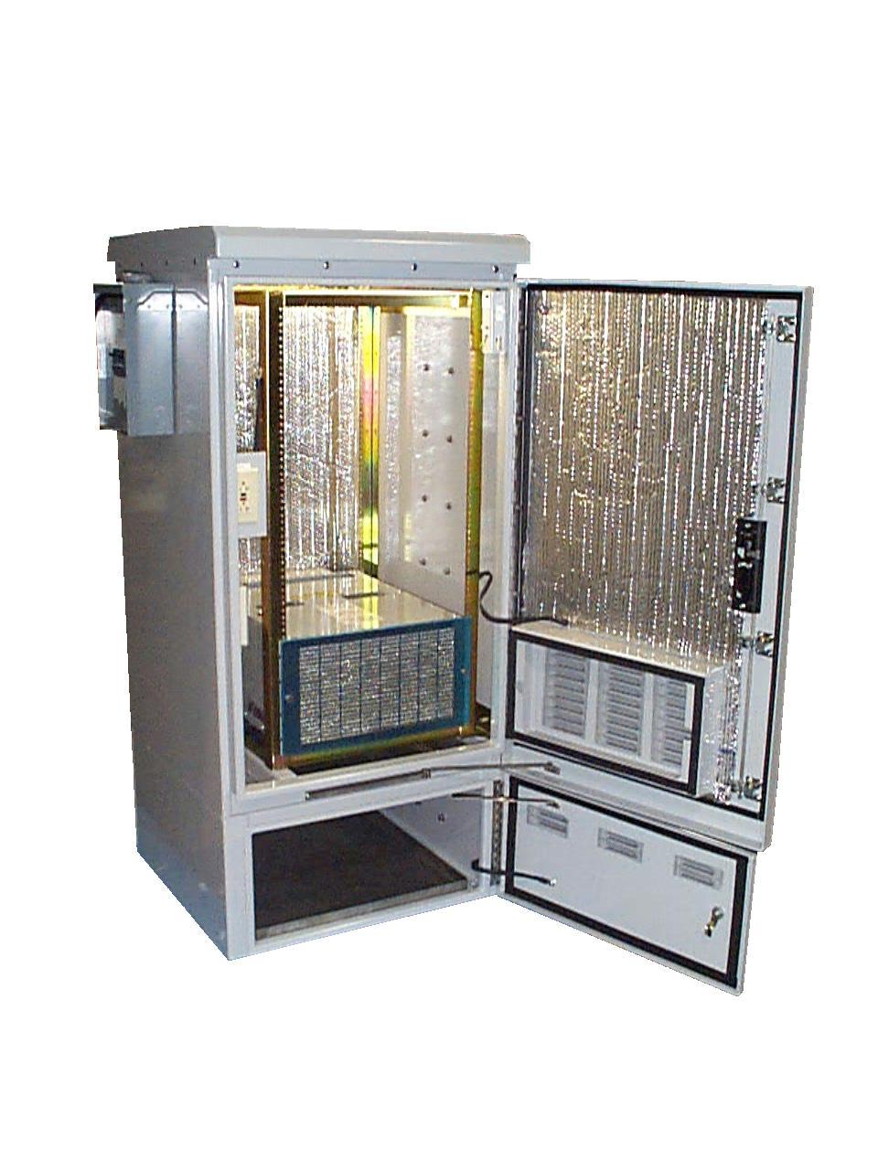
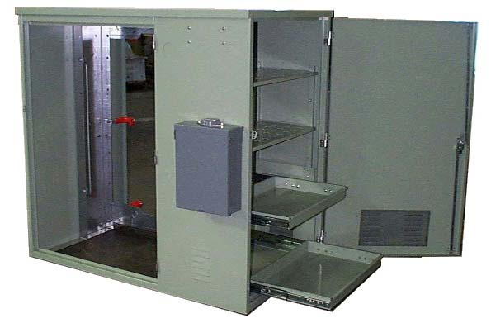
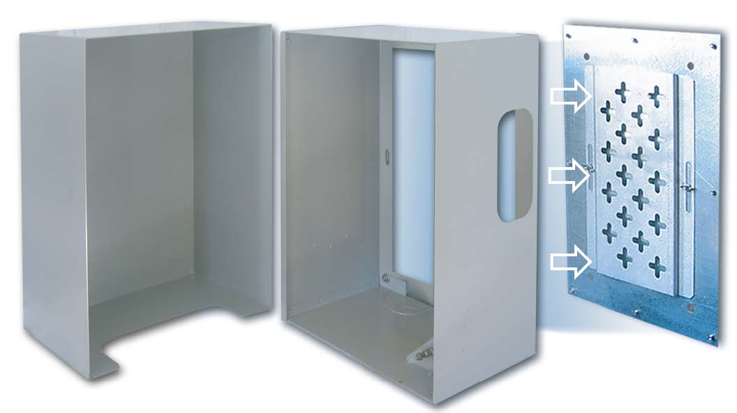
QuaLex Product Continued
Telecom Enclosures

Slide 11
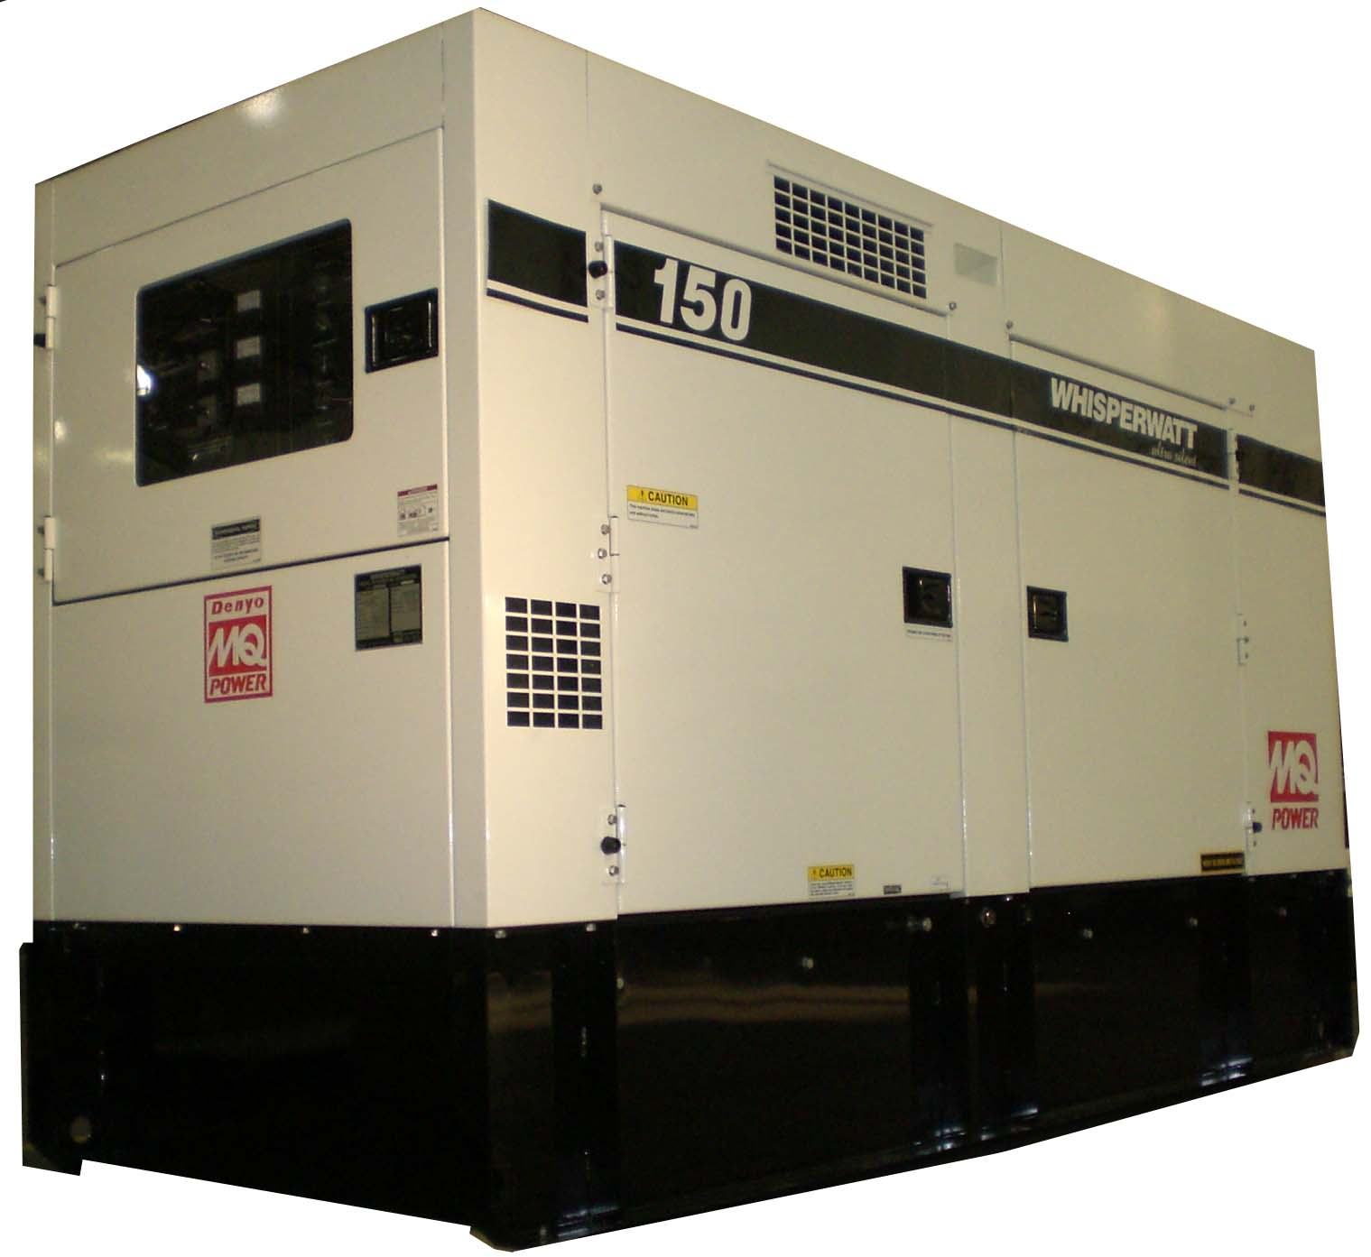
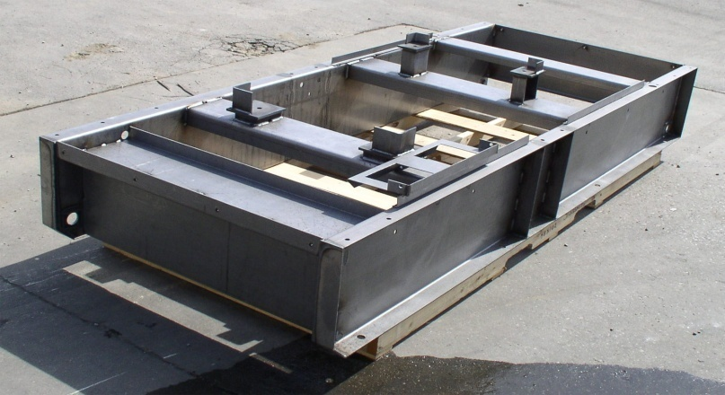
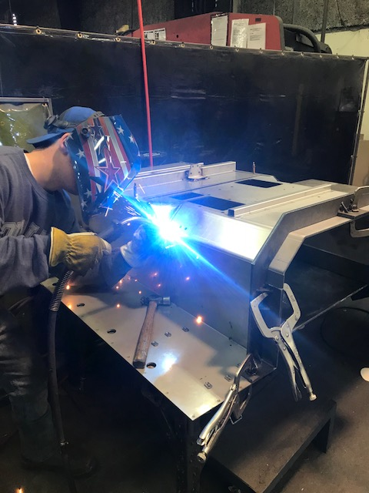
QuaLex Product Continued
Base Fabrications

